Slide 1

SELL BACK
An AICTL Project
Founders
AWAIS
MOAAZ
ABDULLAH
NOORULAIN
MOHID
2025CS152
2025CS169
2025CS133
2025CS122
2025CS128
INSTRUCTOR
MISS.RAMSHA KHALID

Slide 2


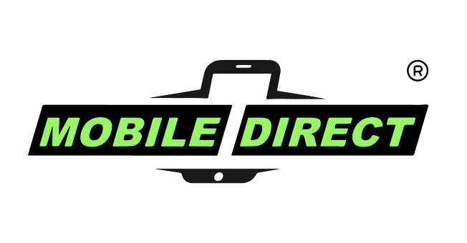
Website UI and INFO:
SELL BACK
Crafting a seamless and intuitive experience for mobile device trade-ins.
Our platform simplifies the process of selling old mobile devices, guiding customers through a seamless 4-step journey. From instant quotes to swift payments, we ensure a convenient and efficient experience.

Slide 3


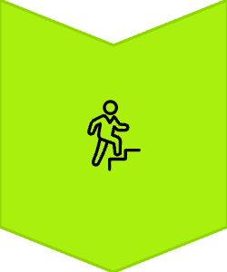
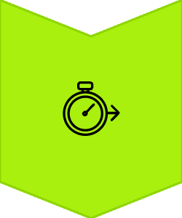

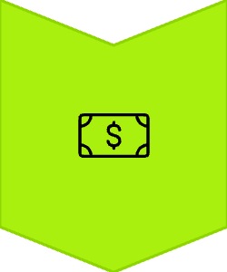

The Core of Our Visual Identity
Visit Website
Vibrant Palette
4-Step Process
A dynamic blend of #A9F00F (Neon Green), #547808 (Deep Olive), #81B61C (Lime Green), and #111A23 (Charcoal Black) for striking contrast and modern appeal.
Instant Quotes
Distinctive Branding
Leveraging neon green accents against a dark backdrop creates a sophisticated yet energetic brand presence, reinforcing our tech-forward image.
Fast Payment
Enhanced User Focus
Strategic colour application guides user attention, highlights key actions, and ensures an engaging journey from start to finish.

Slide 4

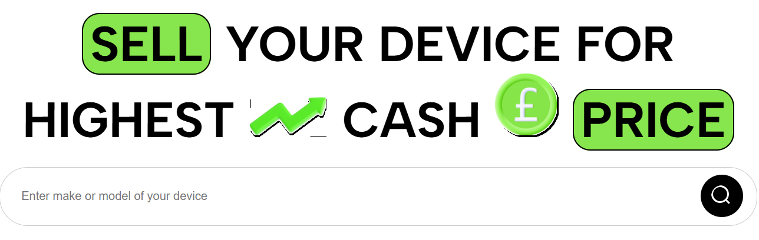

Intuitive Homepage Layout
Our homepage is meticulously designed for immediate impact and effortless navigation. A prominent hero section showcases featured devices or promotions, drawing users in with captivating visuals and clear calls to action.
Below, logically organised sections lead users to popular categories, step-by-step guides, and customer testimonials, ensuring a smooth flow through the trade-in process.

Slide 5
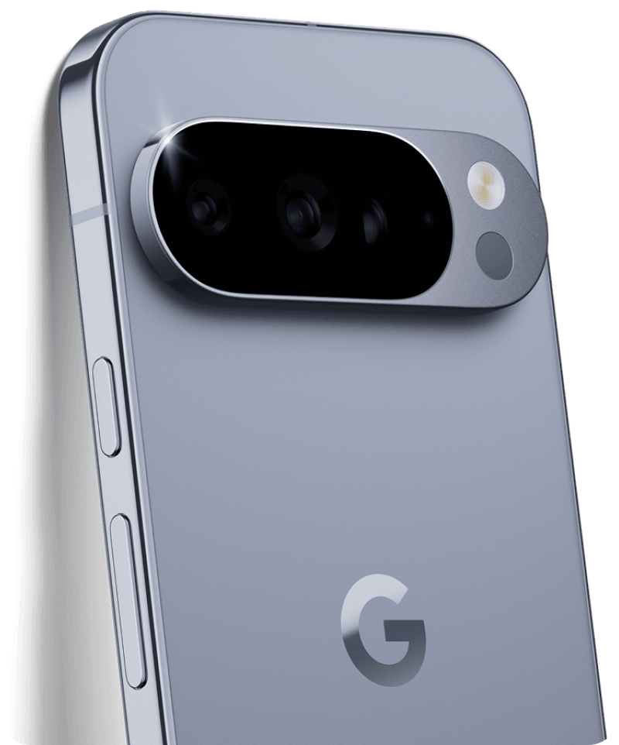

Seamless Navigation Bar Design
The navigation bar is a cornerstone of usability, providing clear pathways to essential areas of the site.
Clean Aesthetics
Minimalist design with clear, concise labels ensures users can quickly find what they need without cognitive overload.
Responsive Behaviour
Optimised for all devices, the navigation intuitively transforms from a sleek horizontal menu to a responsive hamburger menu on smaller screens.
Visual Cues
Subtle neon green highlights indicate the active page, providing instant feedback and enhancing the user's sense of location within the site.

Slide 6
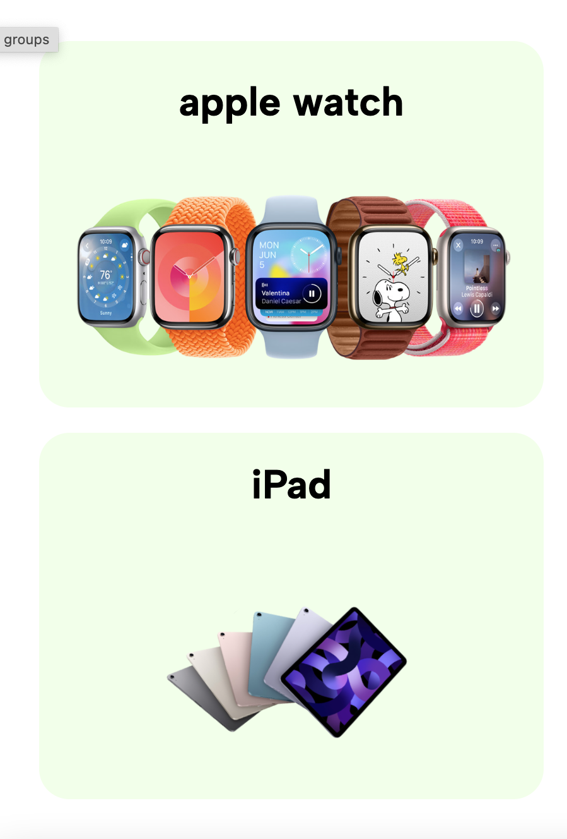
Streamlined Category Cards
Category cards are crafted for clarity and visual appeal, making device selection straightforward and engaging.
Bold Imagery
Concise Information
Each card features high-quality images of devices, immediately conveying the product. This visual emphasis aids recognition and decision-making.
Essential details, such as brand and model, are presented clearly with minimal text, allowing for quick scanning and comprehension.
Interactive Elements
Hover effects and subtle animations provide a dynamic touch, encouraging user interaction and enhancing the overall experience.

Slide 7






Impactful Icons & Visual Elements
Icons and supplementary visual elements are carefully chosen to communicate functionality and enhance aesthetics without clutter.
Eco-Friendly Messaging
Icons highlighting sustainability and responsible recycling efforts resonate with environmentally conscious users.
Security & Trust
Clear visual indicators assure users of data security and reliable transactions, building confidence in the service.
Value Proposition
Icons related to instant quotes and best prices reinforce the financial benefits of using Mobile Direct.

Slide 8
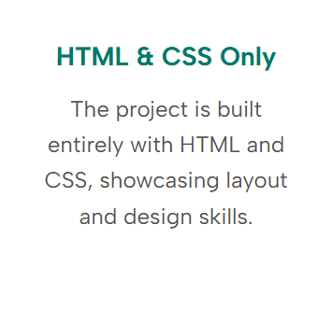
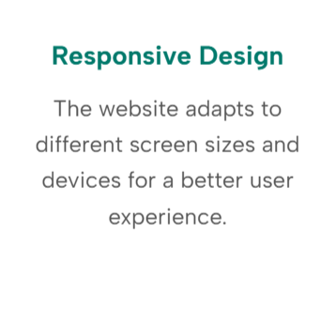
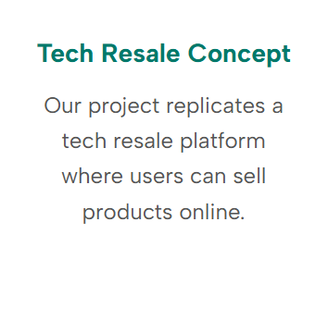
Clarity Through Typography and Spacing
Typography and spacing are paramount in creating a legible and pleasant user interface.
Strategic Font Choices
Optimal Spacing
Generous use of white space around elements reduces visual clutter, guides the eye, and creates a sense of calm and professionalism. This deliberate spacing improves content scannability and user comfort.
A clean, Albert Sans typeface ensures readability across all screen sizes. Headers utilise a bolder weight for emphasis, while body text maintains a comfortable reading experience.
Neon green accents can be sparingly used on key headings or call-to-action text for visual pop.

Slide 9

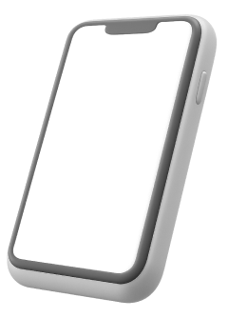

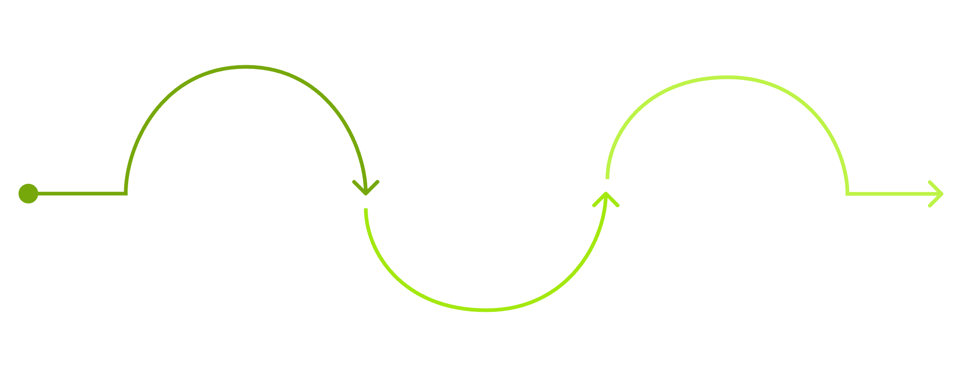


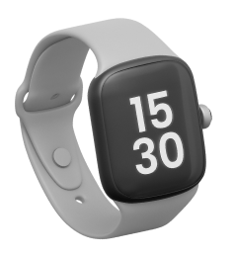
Fluid Responsive Design
Ensuring a consistent and high-quality selling experience for all devices is a core principle of our UI design.
Phone
Console
Wide layout with full navigation and multi-column content
Laptop
Stacked layout with optimized navigation and touch controls
Condensed navigation and responsive content blocks
From desktops to compact mobile phones any device can be sold with interactive elements guaranteeing optimal visual appeal regardless of the device.

Slide 10
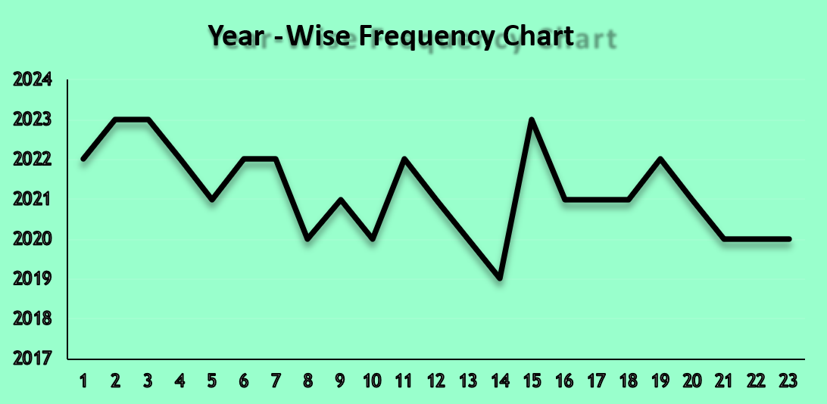
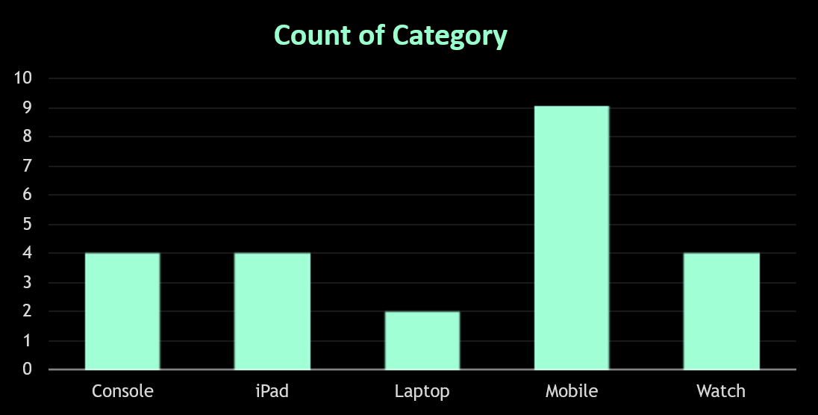
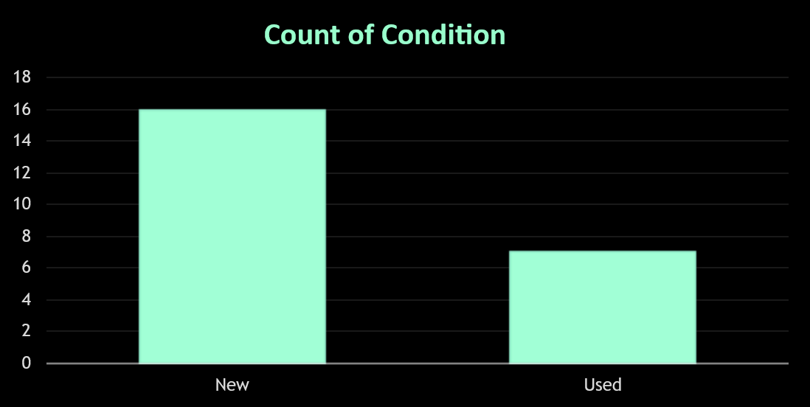
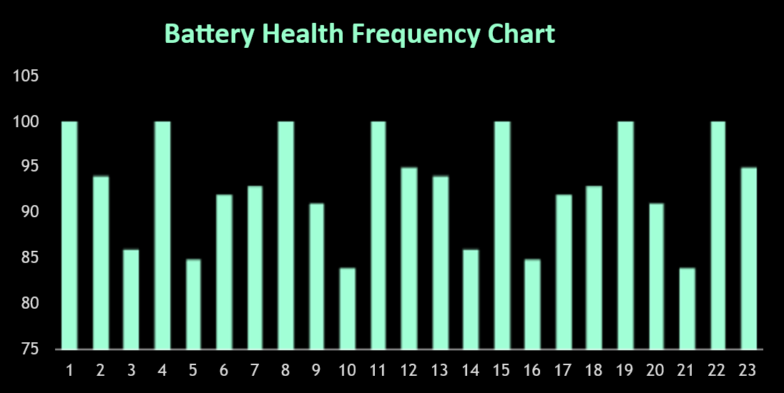
Some Insights
Our mobile buy-back website delivers an exceptionally simple and efficient solution for selling used devices. By harmonizing automation, secure logistics, and rapid payments, we craft a superior user experience.

Slide 11

The LinkedIn Post
The successful completion of this project was made possible through effective teamwork and clear role distribution. Each member contributed across areas such as website development, video creation, presentations, and data analysis. The project also provided valuable hands-on experience with tools like GitHub, MS Word, Excel, and PowerPoint, strengthening technical skills, problem-solving ability, and collaborative development practices. Overall, the project served as a meaningful learning experience and contributed significantly to technical and professional growth.

Slide 12
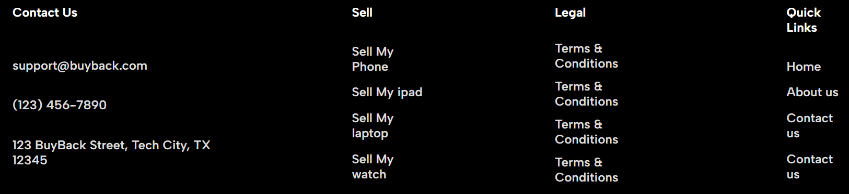
Final UI Summary: A Unified Vision
Our UI/UX design culminates in a sophisticated, user-centric platform that prioritises clarity, engagement, and efficiency.
Intuitive Interactions
Visually Striking
Performance-Driven
A modern aesthetic with vibrant accents captures attention.
Every click and swipe is designed to be purposeful and frictionless.
Optimised for speed and responsiveness.
This design not only meets but anticipates user needs, creating a delightful and efficient trade-in journey.

Slide 13
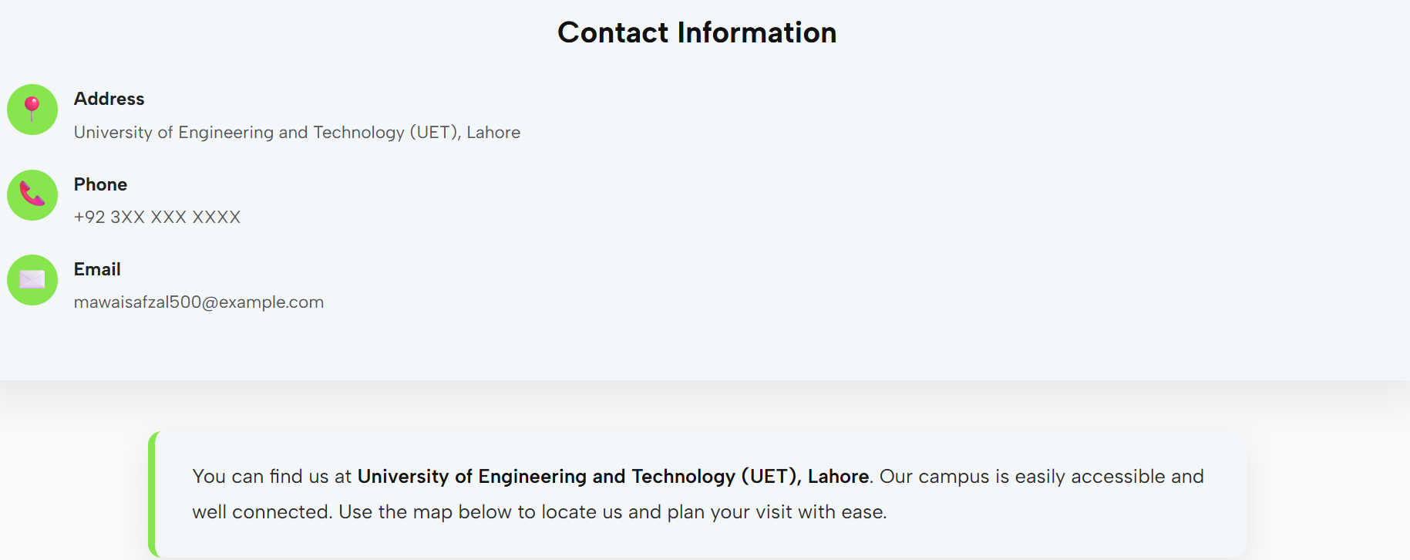
Thank You
We believe this UI/UX design for SELL BACK sets a new standard for clarity, engagement, and efficiency in the mobile device buy-back market. Your feedback is invaluable as we move forward.

